Slide 1


CPU Register Design (Direct & Indirect)
Haijian Sun
sunh@uww.edu
Notes:
http://mr-g.tistory.com/60
you are the great programmer who knows not only a programming language but also system programming.

Slide 2
Learning Object
CPU Register Design (Programmer’s Perspective)
CPU Register Design
Direct & Indirect Mode Design

Slide 3

Limitation of Load & Store
Limited storage (Issues on Direct Mode)
Instruction can describe only between 0x0000 and 0x00ff in main memory
(ff)₁₆ = (1111 1111)₂
Can not describe over 0x0100 in main memory address
Reservation
LOAD
Destination
Source
0 0
LOAD instruction
8 bits for main memory address

Slide 4


CPU Register Design
Okay
Okay, now I want to use more memory.
Program Developer
Hardware Engineer
Increasing size of main memory
(> 0x0100)
Let’s use reservation bit
Current Register only manages 0x00 ~ 0xFF address.
Need another instructions.

Slide 5
Solution for Memory Limitation
Let CPU know what main memory contains
Store address between 0x00 and 0xff
OR
Value 100
Address 0x100
In Memory (Direct)
In Memory (Indirect)
Reservation
LOAD
Destination
Source
LOAD instruction
Use the Reservation bit to let CPU know what is in the memory (number or address) in the Source address
8 bits for main memory address

Slide 6
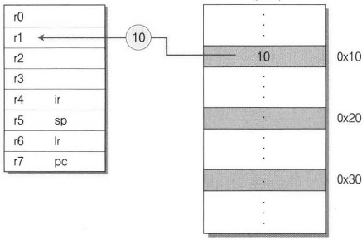
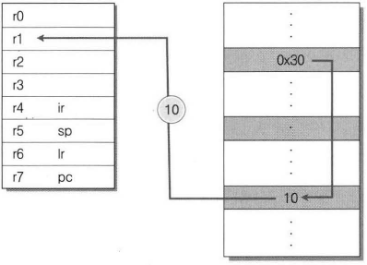
Indirect Addressing Mode
Indirect Mode
Reference the address in main memory
Solve the issue of direct addressing mode
E.g. LOAD r1, [0x10]
LOAD r1, 0x10
LOAD r1, [0x10]
Direct Addressing
Indirect Addressing
Notes:
Using Bracket, the indirect address is displayed.

Slide 7




How to Distinguish Modes
Reserved bits (2 bits)
Let 11 on reservation for Indirect Mode
Reserved bit for Mode
Indirect Addressing
LOAD r1, [0x07]
Notes:
How to distinguish the modes.

Slide 8
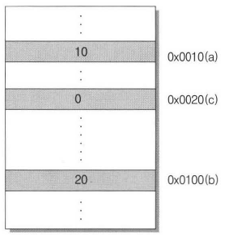
Example Indirect Mode
int a = 10
LOAD r1, 0x0010
Only control register
Int b = 20 (Making Indirect)
Need to put 0x0100 (256) between 0x00 and 0xff
MUL r0, 4, 4
r0 = 4 x 4
MUL r2, 4, 4
r2 = 4 x 4
MUL r3, r0, r2
r3 = r0 x r2 // Get 0x0100 (256)
int a = 10; //allocate 0x0010
int b = 20; //allocate 0x0100
int c = 0; //allocate 0x0020
c = a + b
Let the code is already on Memory
How to access?
Notes:
Hexadecimal

Slide 9
Example Indirect Mode (cont.)
Use Indirect Mode
First we need store the address on memory
STORE r3, 0x0030
-> 0x0100 (main memory address)
Load the data using Indirect Mode
LOAD r2, [0x0030]
c = a + b
ADD r3, r1, r2
Store r3 0x0020
0x0100
0x0030
int a = 10; //allocate 0x0010
int b = 20; //allocate 0x0100
int c = 0; //allocate 0x0020
c = a + b
Notes:
Hexadecimal

Slide 10
Practices
Program:
int a = 10; //allocate 0x0010
int b = 20; //allocate 0x0200 (512)
int c = 0; //allocate 0x0100 (256)
c = a / b;
Assembly Code:
Need to save 0x0200 address between 0x00 and 0xff
Let’s make binary code:
Make it
Make it
0x0200
0x0100
0x0030
0
0x0100
0x0200
Notes:
LOAD r1, 0x10
MUL r0, 4, 4
MUL r2, r0, r0
MUL r0, r2, 2
STORE r0 0x0020
STORE r2 0x0030
LOAD r2, [0x0020]
DIV r3, r1, r2
STORE r3, [0x0030]

Slide 11
Program Flow with Mode
LOAD r1, 0x10
MUL r0, 4, 4
MUL r2, 4, 4
MUL r3, r0, r2
STORE r3, 0x0030
LOAD r2, [0x0030]
ADD r3, r1, r2
STORE r3, 0x20
00…
00..
00..
00..
00 …
11…
00 …
int a = 10; //allocate 0x0010
int b = 20; //allocate 0x0100
int c = a + b //allocate 0x0020
2. Assemble
1. Compile
Memory
CPU
6. Execution
ALU
r0
10
r1
r2
Store
0x100
r3
r4 ir
Control Unit
r5 sp
0x0100
0x0030
r6 lr
Indirect
3. Fetch
r7 pc
5. Decode
I/O BUS
10
0x100

Slide 12
Program Flow with Mode
LOAD r1, 0x10
MUL r0, 4, 4
MUL r2, 4, 4
MUL r3, r0, r2
STORE r3, 0x0030
LOAD r2, [0x0030]
ADD r3, r1, r2
STORE r3, 0x0020
00…
00..
00..
00..
01 …
11…
00 …
int a = 10; //allocate 0x0010
int b = 20; //allocate 0x0100
int c = a + b //allocate 0x0020
2. Assemble
1. Compile
Memory
CPU
6. Execution
ALU
r0
10
r1
LOAD
20
r2
30
r3
r4 ir
Control Unit
r5 sp
0x0100
0x0030
r6 lr
3. Fetch
r7 pc
5. Decode
I/O BUS
10
20
30

Slide 13


Summary
Indirect Mode (11)
Reference the address in main memory
E.g. LOAD r1, [0x10]
CPU Don’t know what is in there.
(number or addr)
CPU: Oh! first two bits is 11. So, it is not a number (data). Let move to the address.
LOAD r1, 0x10
LOAD r1, [0x10]
Direct Addressing
Indirect Addressing
CPU: I got the data from the address.
Notes:
Using Bracket, the indirect address is displayed.

Slide 14
Summary – cont.
Oh, my ‘b’ variable is stored at 0x0100 in main memory.
Need to store the 0x100 in one of address between 0x00 and 0xff in main memory, because, STORE and LOAD have only 8 bits for main address.
int a = 10; //allocate 0x0010
int b = 20; //allocate 0x0100
int c = 0; //allocate 0x0020
c = a + b
First, let’s make 0x0100
MUL r0, 4, 4 4 * 4 = 16 ( r0 has 16 bits – it can store)
MUL r2, 4, 4 4* 4 = 16 ( r2 has 16 bits – it can store)
MUL r3, r0, r2 r0 * r2 = 256 ( r3 store the 256 (256)₁₀ = (100)₁₆)
Store the r3 value one of address between 0x00 and 0xff
STORE r3, 0x0030 <= 100 is saved at 0x0030 address
To use the value => LOAD r2, [0x0030]
Use bracket give information: the 0x0030 has another memory address, not number
Notes:
Load and Store instruction can only access between 00 and ff.
bracket

Slide 15
Summary and Review
LOAD r1, 0x10
MUL r0, 4, 4
MUL r2, 4, 4
MUL r3, r0, r2
STORE r3, 0x0030
LOAD r2, [0x0030]
ADD r3, r1, r2
STORE r3, 0x0020
00…
00..
00..
00..
00 …
11…
00 …
int a = 10; //allocate 0x0010
int b = 20; //allocate 0x0100
int c = a + b //allocate 0x0020
2. Assemble
1. Compile
Memory
CPU
6. Execution
ALU
r0
10
r1
LOAD
20
r2
30
r3
r4 ir
Control Unit
r5 sp
0x0100
0x0030
r6 lr
3. Fetch
r7 pc
5. Decode
I/O BUS
10
20
30

